Slide 1
Project Scope Management
Chapter 5

Slide 2
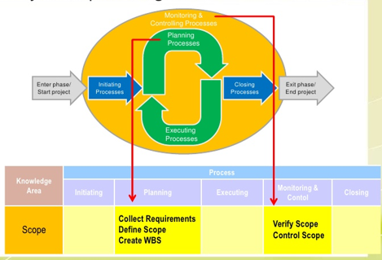
What is Project Scope Management?
Scope refers to all the work involved in creating the products of the project and the processes used to create them

Slide 3
Project Scope Management Processes
Process Group | Integration Management Process | Major Output
Planning | P1: Plan Scope Management | Scope Mgmt Plan Requirement Mgmt Plan
 | P2: Collect Requirements | Req. Documentation Req. Traceability Matrix
 | P3: Define Scope | Project Scope Stmt Project Docs Update
 | P4: Create WBS | Scope Baseline Project Docs Update
Monitoring and Controlling | MC1: Validate Scope | Accept Deliverables Change Requests Work Performance Info
 | MC2: Control Scope | Change Requests Project Mgmt Plan Updates Org, Process Asset Updates

Slide 4
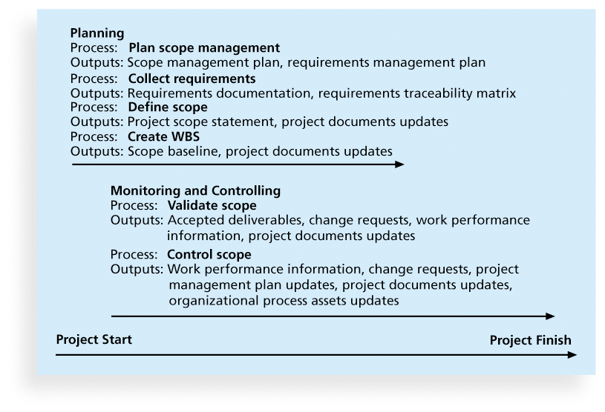
Project Scope Management Processes
Planning scope
Collecting requirements
Defining scope
Creating the WBS
Validating scope
Controlling scope

Slide 5
P3: Project Scope Statement - Exercise
POQ Organization – Online Shoe Store
Review the exercise and answer the questions at the bottom of the sheet
We will discuss each of these questions and then create the scope statement

Slide 6
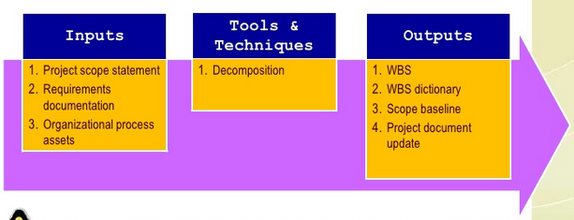
P4: Creating the Work Breakdown Structure (WBS)
A WBS is a deliverable-oriented grouping of the work involved in a project that defines the total scope of the project

Slide 7
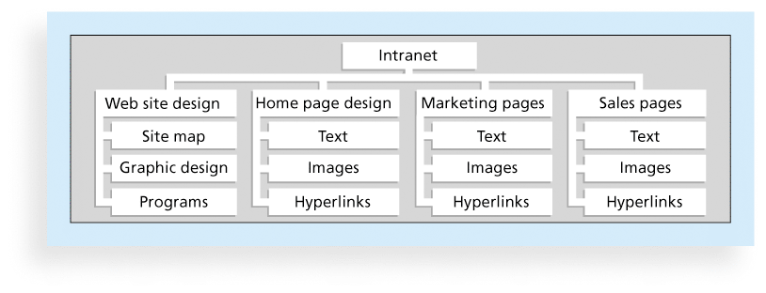
P4: Sample Intranet WBS (Organized by Product )

Slide 8
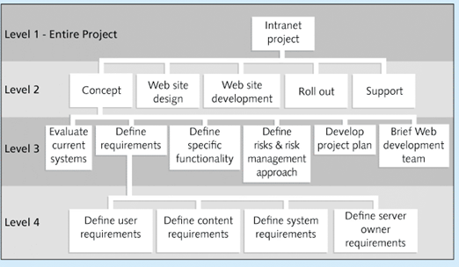
P4: Sample Intranet WBS (Organized by Phase)

Slide 9
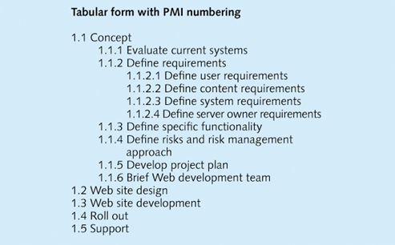
P4: Sample Intranet WBS (Organized by Phase)
Level 2
Level 3
Level 4

Slide 10
PMI Practice Standard for WBS 100 % Rule
WBS should include 100% of the work defined by the project scope and capture ALL deliverables (internal, external, interim) in terms of work to be completed

Slide 11
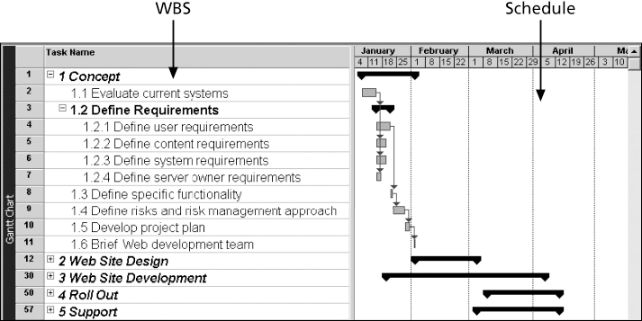
P4: Intranet WBS and Gantt Chart in MS Project

Slide 12
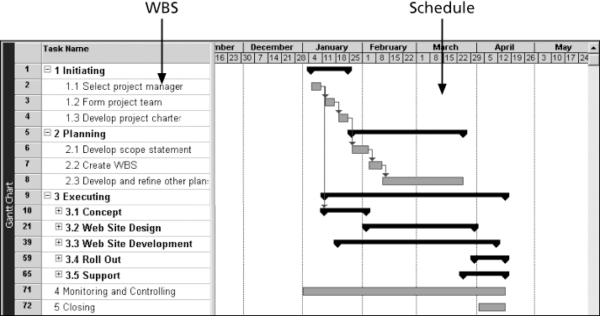
P4: Intranet Gantt Chart Organized by Project Management Process Groups

Slide 13
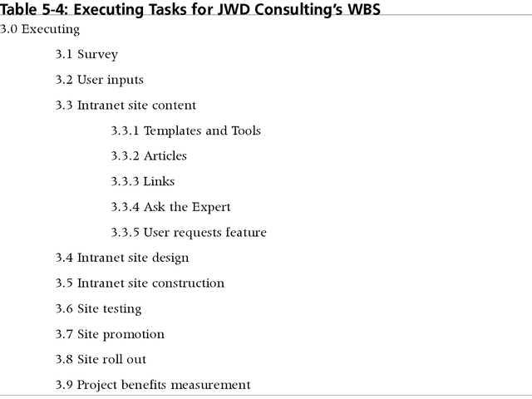
P4: Executing Tasks for JWD Consulting’s WBS

Slide 14
Approaches to Developing a WBS
Using guidelines: Some organizations, like the DOD, provide guidelines for preparing WBSs
analogy approach
top-down approach
bottom-up approach
Mind-mapping approach

Slide 15
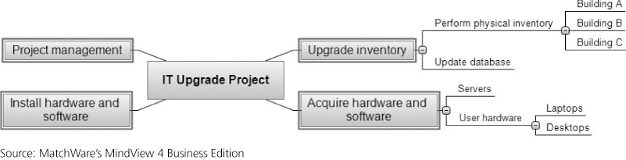
Figure 5-7. Sample Mind-Mapping Approach for Creating a WBS

Slide 16
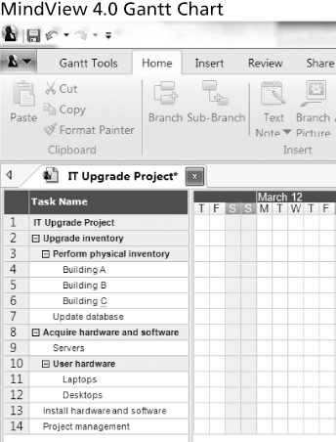
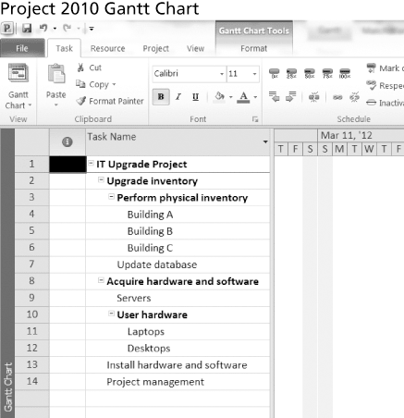
Figure 5-8. Gantt Charts With WBS Generated From a Mind Map

Slide 17
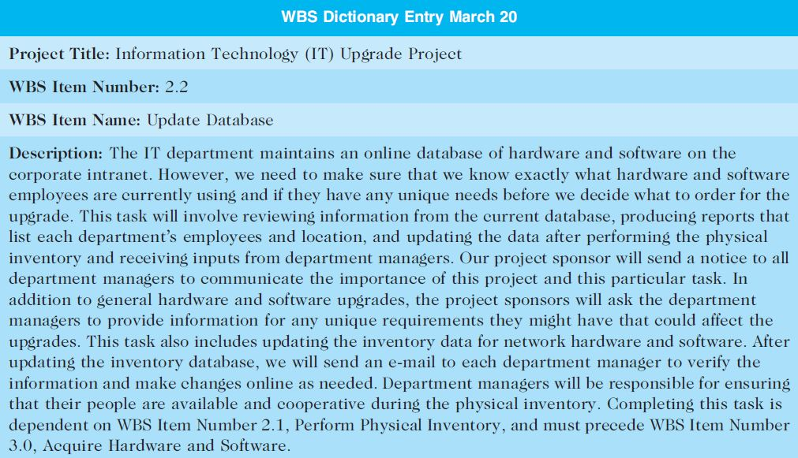
The WBS Dictionary and Scope Baseline
Many tasks are vague and must be explained more so people know what to do and can estimate how long it will take and what it will cost
WBS Dictionary

Slide 18
Advice for Creating a WBS and WBS Dictionary
Unit of work should appear only once in WBS.
Work content of WBS item is sum of items below
Limit responsibility of a WBS item to one individual
(even though many people may be working on it)
Project team member involvement in developing
Document WBS items in WBS Dictionary

Slide 19
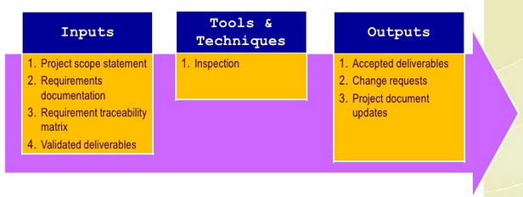
Validating Scope
Scope validation involves formal acceptance of the completed project deliverables
Acceptance is often achieved by a customer inspection and then sign-off on key deliverables

Slide 20
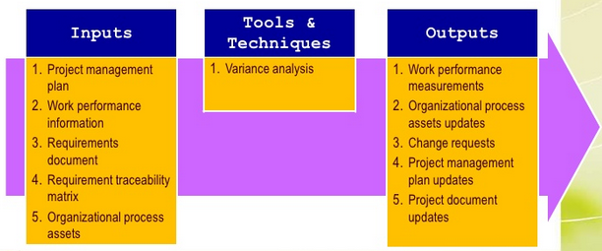
Controlling Scope
Scope control involves controlling changes to the project scope

Slide 21
Controlling Scope
Goals of scope control
influence the factors that cause scope changes
assure changes are processed according to procedures developed as part of integrated change control
manage changes when they occur
Variance is the difference between planned and actual performance

Slide 22

Avoiding Scope Creep
Scope creep may occur as a result of:
Poor change control
Lack of proper initial identification and/or documentation of the features that are required for the achievement of project objectives
Weak project manager or executive sponsor

Slide 23
Scope Creep
To mitigate these types of issues, the proposed solutions are the following:
Define requirements as “must-haves” and “nice to haves”
Set project expectations
Agree on deliverables, and document
Document and review business requirements

Slide 24
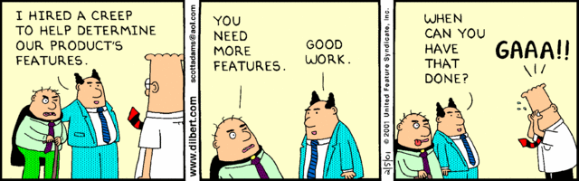
Best Practices - Avoiding Scope Problems
1. Keep the scope realistic. Don’t make projects so large that they can’t be completed.
2. Involve users in project scope management.
3. Use off-the-shelf hardware and software whenever possible.
4. Follow good project management processes.

Slide 25
Scope Problems -> Project Failures
A project scope that is too broad and grandiose can cause severe problems
FoxMeyer Drug
McDonalds

Slide 26
Improving User Input
Develop a good project selection process and insist that sponsors are from the user organization
Have users on the project team in important roles
Have regular meetings with defined agendas, and have users sign off on key deliverables presented at meetings

Slide 27
Improving User Input
Deliver something to users and sponsors on a regular basis
Don’t promise to deliver when you know you can’t
Co-locate users with developers

Slide 28
Reduce Incomplete and Changing Requirements
Requirements management process
Use techniques to get user involvement
Document and maintain requirements
Create a requirements management database
Testing throughout the project life cycle
Review changes from a systems perspective

Slide 29
Using Software to Assist in Project Scope Management
Word-processing software helps create several scope-related documents
Spreadsheets help to perform financial calculations, weighed scoring models, and develop charts and graphs
Communication software like e-mail and the Web help clarify and communicate scope information
Project management software helps in creating a WBS, the basis for tasks on a Gantt chart
Specialized software is available to assist in project scope management

Slide 30
Chapter Summary
Project scope management
Main processes include:
Define scope management
Collect requirements
Define scope (scope statement)
Create WBS
Validate scope
Control scope

